Slide 1
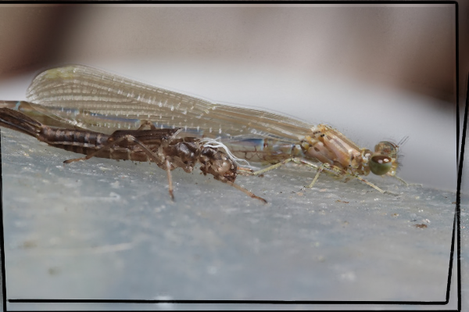
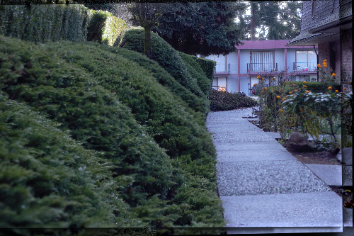
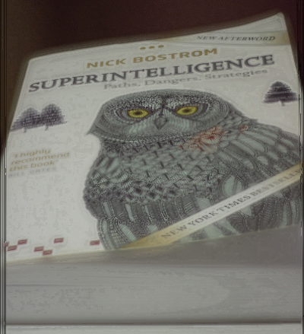
Laplacian Pyramids for Focus Stacking
This project attempts to reproduce Wang and Chang’s 2011 paper on using Laplacian pyramids to fuse images with different focal planes. It also explores simpler and faster alternatives and compares the trade-offs.
Computational Photography @ GT

Slide 2
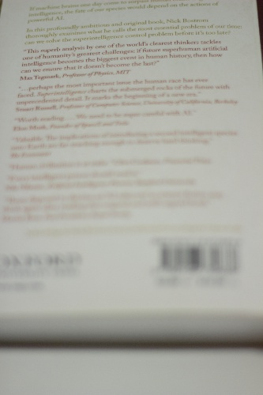
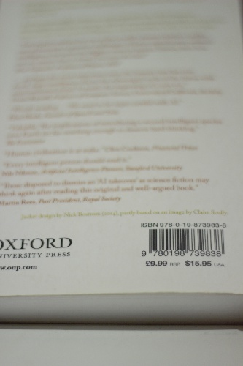
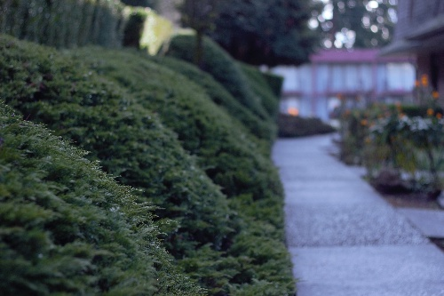
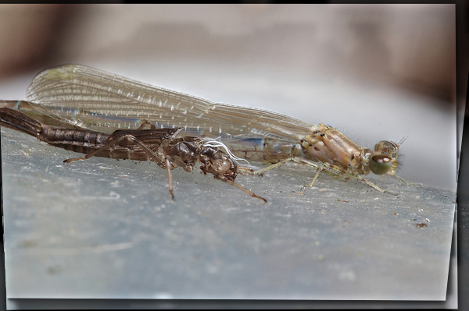
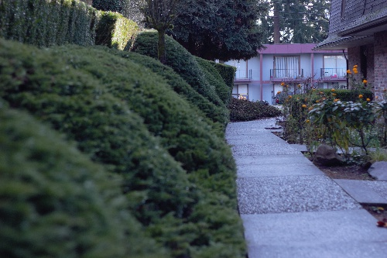
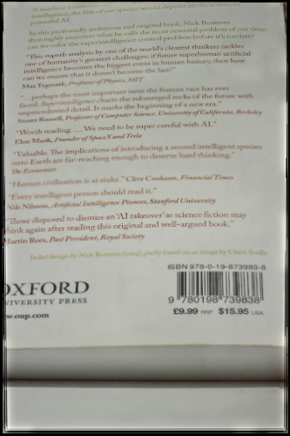
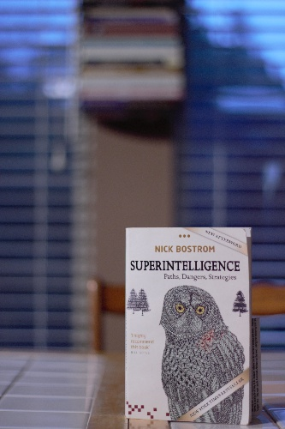
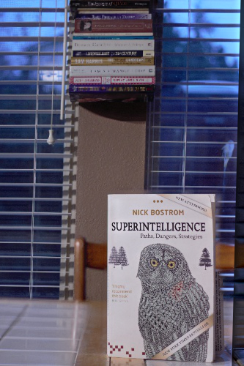
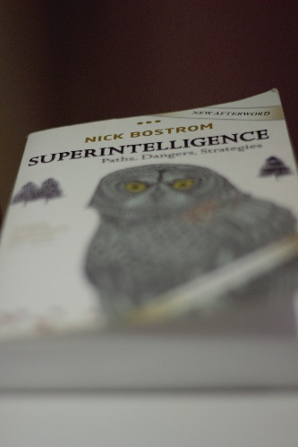
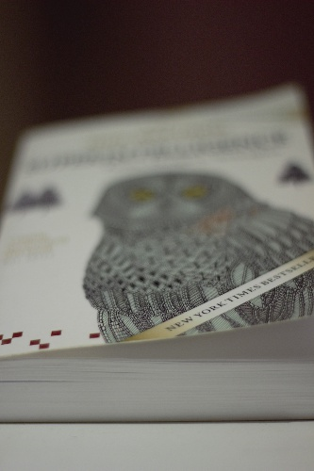
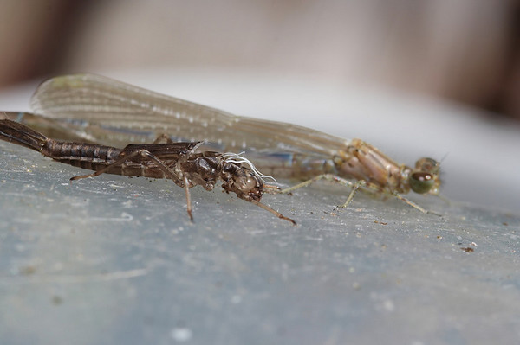
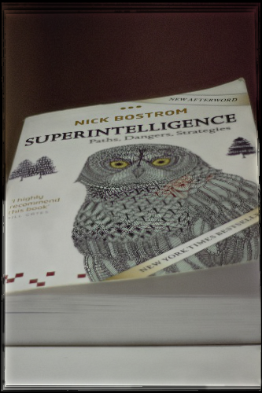
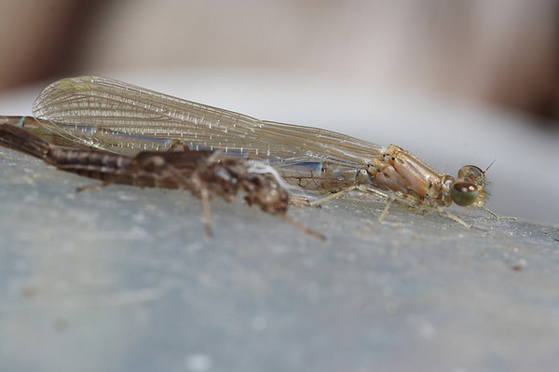
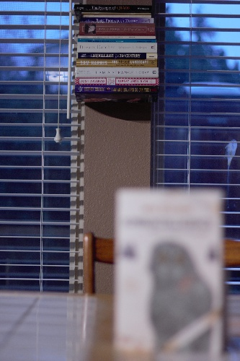
Showcase
Computational Photography @ GT

Slide 3
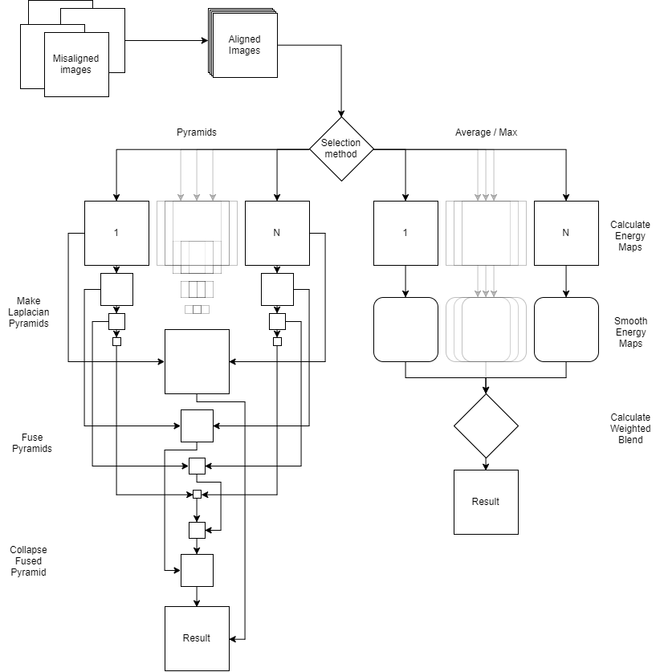
Project Pipeline
First, align the images. This project used the ECC method of image alignment available in OpenCV 3
For the pyramid selection method, the next steps are:
Compute the Laplacian pyramids for each image
Fuse the top (smallest) image in the pyramid using entropy and divergence.
Fuse the remaining pyramid layers using maximum region energy
Collapse the fused pyramid
For average / max methods:
Calculate the energy maps for each image
Smooth the energy maps with a bilateral filter
Calculate the weighted blend using the average or maximum of the energy maps
Blend the aligned images with the calculated weighted blend
Computational Photography @ GT

Slide 4
Project Pipeline (Alignment)
Before blending, the images must be first be aligned. We have done this before in the Panorama assignment using ORB keypoints, but I decided to use the ECC method available in OpenCV for this project. I chose ECC because its configurable parameters and iterative nature were more intuitive to me. Though not implemented in this project, it would be a matter of only a few extra lines to give the user the ability to control the number of ECC iterations and stopping criterion epsilon in the alignment process.
Computational Photography @ GT

Slide 5
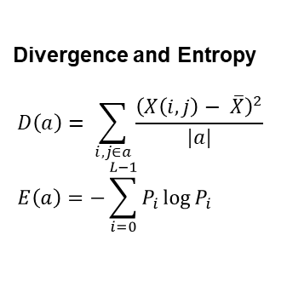
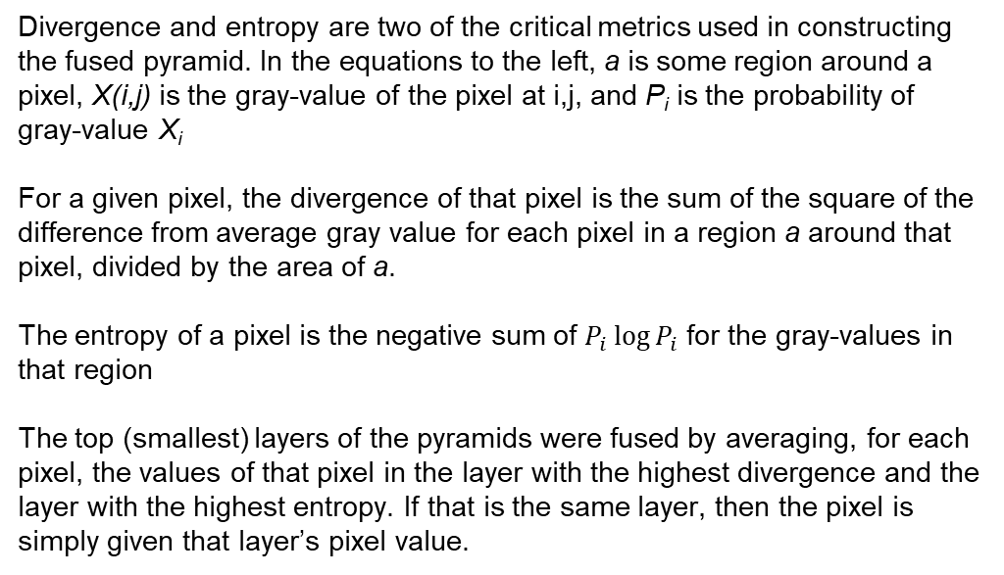
Project Pipeline (Pyramids)
Divergence and Entropy
$$D\left(a\right)= \sum_{i, j∈a}{\frac{{\left(X\left(i, j\right)− \overline{X}\right)}^{2}}{|a|}} \\ E\left(a\right)=−\sum_{i=0}^{L−1}{P_{i}\log{P_{i}}}$$
Divergence and entropy are two of the critical metrics used in constructing the fused pyramid. In the equations to the left, a is some region around a pixel, X(i,j) is the gray-value of the pixel at i,j, and P_{i} is the probability of gray-value X_{i}
For a given pixel, the divergence of that pixel is the sum of the square of the difference from average gray value for each pixel in a region a around that pixel, divided by the area of a.
The entropy of a pixel is the negative sum of $P_{i}\log{P_{i}}$ for the gray-values in that region
The top (smallest) layers of the pyramids were fused by averaging, for each pixel, the values of that pixel in the layer with the highest divergence and the layer with the highest entropy. If that is the same layer, then the pixel is simply given that layer’s pixel value.
Computational Photography @ GT

Slide 6
Project Pipeline (Pyramids, cont’d)
The remaining pyramid layers are blended using maximum region energy. This can be found simply by convolving the square of the grayscale version of that layer with the same binomial kernel used in the Gaussian pyramid subsampling process. The fused Laplacian layer is generating by choosing, for each pixel, the value of the corresponding pixel in the layer with the highest region energy for that pixel.
Computational Photography @ GT

Slide 7
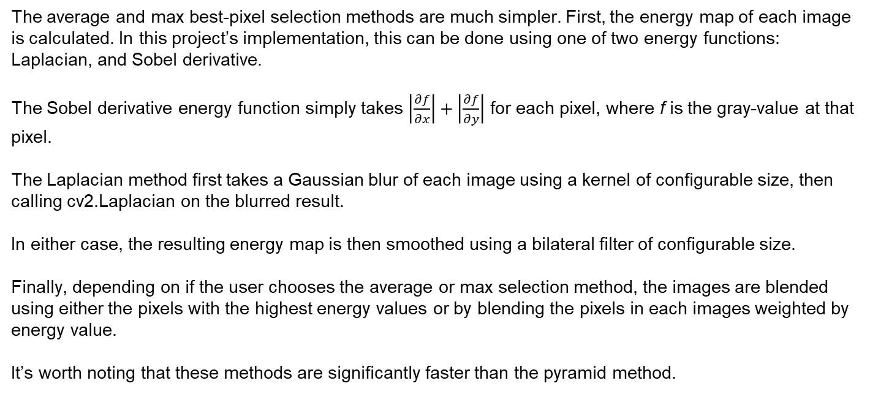
Project Pipeline (Average / Max)
The average and max best-pixel selection methods are much simpler. First, the energy map of each image is calculated. In this project’s implementation, this can be done using one of two energy functions: Laplacian, and Sobel derivative.
The Sobel derivative energy function simply takes $\left|\frac{∂f}{∂x}\right|+\left|\frac{∂f}{∂y}\right|$ for each pixel, where f is the gray-value at that pixel.
The Laplacian method first takes a Gaussian blur of each image using a kernel of configurable size, then calling cv2.Laplacian on the blurred result.
In either case, the resulting energy map is then smoothed using a bilateral filter of configurable size.
Finally, depending on if the user chooses the average or max selection method, the images are blended using either the pixels with the highest energy values or by blending the pixels in each images weighted by energy value.
It’s worth noting that these methods are significantly faster than the pyramid method.
Computational Photography @ GT

Slide 8
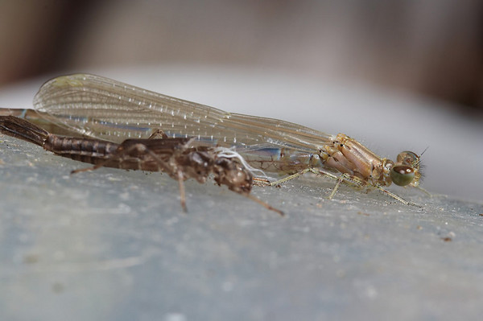
Demonstration: Result Sets
First up is a set of three images of a damselfly by its empty shell. I found this image set on Wonderful Photos while researching image stacking.
In the first image, the shell is in focus. The next two images gradually shift focus to the damselfly behind it.
As can be seen in the following examples, the pyramid and average Laplacian methods produce very similar results, though the pyramid method is a bit sharper. The max energy method has a lot of artifacts in the background. The pyramid method also struggles a bit in that regard, but the simple smoothed average Laplacian has no issues. All methods have a bit of ghosting around the damselfly’s eyes
Computational Photography @ GT

Slide 9


Demonstration: Result Sets
Pyramid
Average Laplacian
Average Laplacian (unsmoothed)
Average Sobel
Computational Photography @ GT

Slide 10
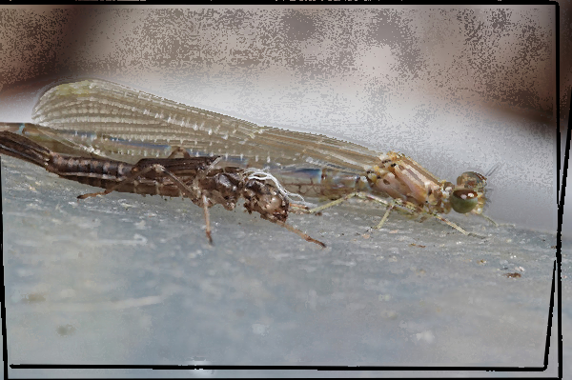
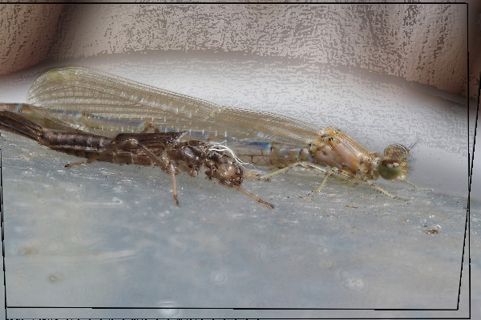
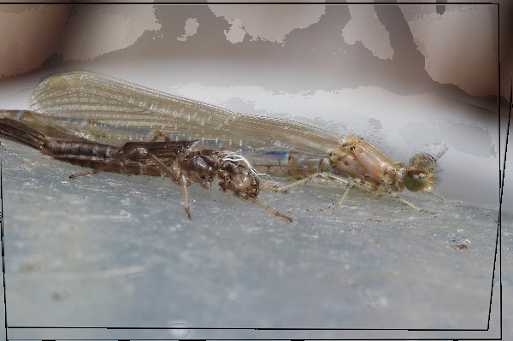
Demonstration: Result Sets
Pyramid
Max Laplacian
Max Laplacian (unsmoothed)
Max Sobel
Computational Photography @ GT

Slide 11
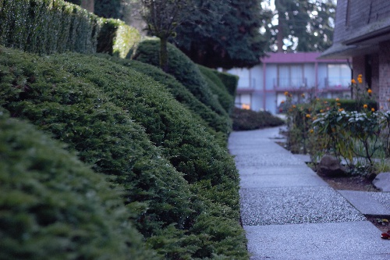
Demonstration: Result Sets
Next up is a set of three images I took in front of my house. We rack focus from the apartment building in the background, down the lane, and to the bushes in the foreground.
For this set, I think the max energy method produces the sharpest result. Both the pyramid and average method produce a bit of a blooming effect around the balcony of the building in the background. The max method doesn’t suffer from that effect, and the bushes in the foreground are also sharper.
I took these images without a tripod (notice the big differences in the building on the right), and the alignment stage was able to align them without issue.
Computational Photography @ GT

Slide 12
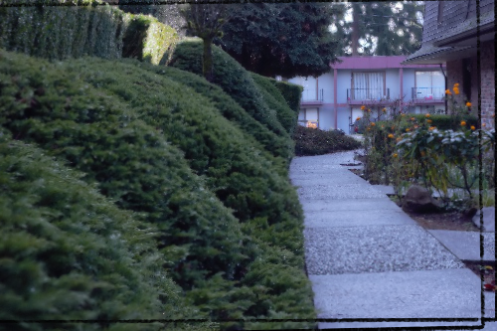

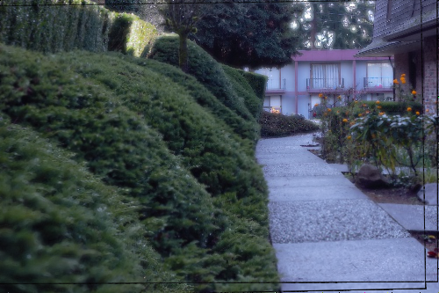
Demonstration: Result Sets
Pyramid
Avg Laplacian
Avg Laplacian (unsmoothed)
Avg Sobel
Computational Photography @ GT

Slide 13
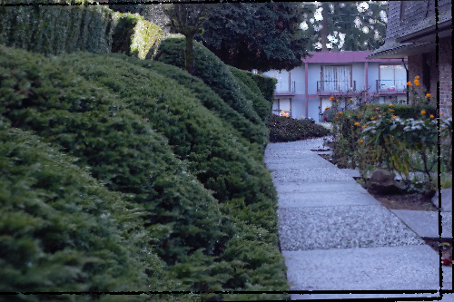

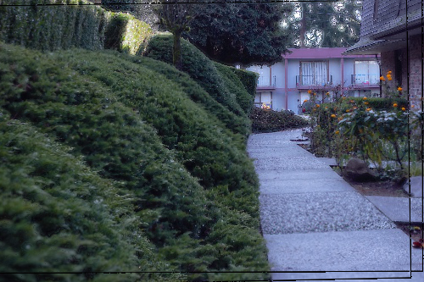
Demonstration: Result Sets
Pyramid
Max Laplacian
Max Laplacian (unsmoothed)
Max Sobel
Computational Photography @ GT

Slide 14
Demonstration: Result Sets
This is a simpler image set, with clear background/foreground objects and not as much of a gradual transition as the others.
In the foreground I propped up the book Superintelligence by Nick Bostrom (highly recommended) on the. In the background we can see a floating bookshelf and blinds. Lots of sharp lines there, it will be interesting to see how the algorithms handle them. Will the titles still be legible?
The pyramid method is hands-down the winner here. The max method has serious artifacting between the blinds, and the average method has a lot of ghosting around the book in the foreground. The pyramid method has none of these issue, and the titles on the spines of the books in the background are nice and sharp.
Computational Photography @ GT

Slide 15
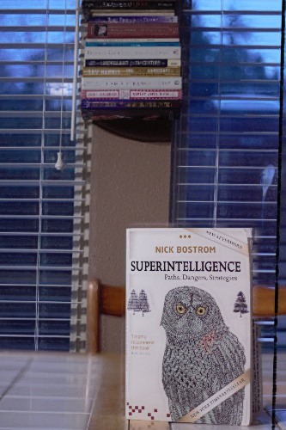

Demonstration: Result Sets
Pyramid
Avg Laplacian
Max Laplacian
Computational Photography @ GT

Slide 16
Demonstration: Result Sets
For the full collection of five result sets,
with nine blended version of each set,
please see the images/output folder
Computational Photography @ GT

Slide 17
Project Development
Research is the first step of any project. Unfortunately, I seem to have forgotten that. I didn’t pay close enough attention the paper I originally chose to try and replicate. I therefore didn’t notice that its focus stacking algorithms used an unspecified machine learning technique to estimate focus depth. Hitting the interwebs again, I found Wang and Chang’s paper with its clear, pyramid-based method, and we were off to the races!
Before trying to implement the pyramid fusion technique, I first wanted to make sure that my image alignment pipeline stage was working properly. I didn’t have great success with the panorama assignment (lots of ghosting), so I decided to research if there were any alternatives to the ORB keypoints method. Lo and behold, I found out about ECC image alignment, added in OpenCV 3.
So, that’s where I started…

Slide 18
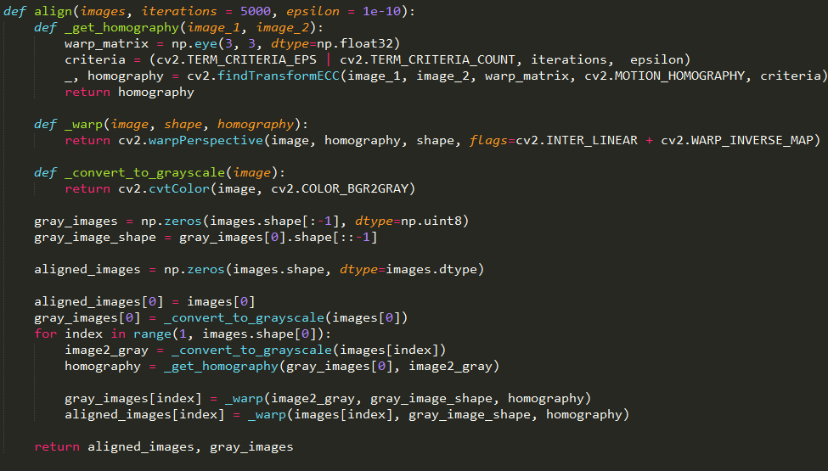
Project Development (alignment)
This iterative alignment method generates a homography, just like the keypoints method we used in panorama. However, it is much simpler to use (though I suspect it is a bit slower).
The image is first converted to grayscale, then the homography is found by matching each image to the first image. “First” here doesn’t have any significance, there is no important ordering, it’s just important that they are all aligned to the same image.
Both the grayscale and color images are then warped to match the first image using the calculated homography.
Both the aligned and grayscale images are returned, which saves some time later in the pipeline.

Slide 19
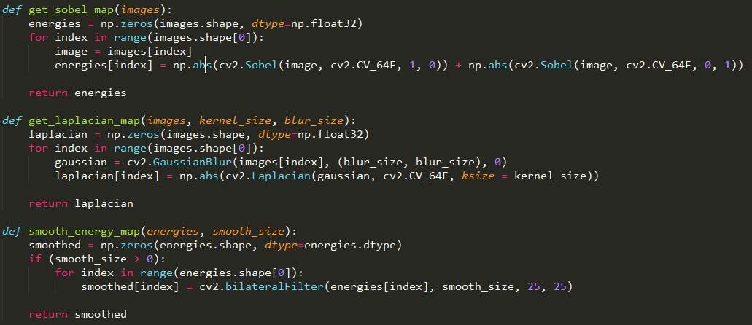
Project Development (energy maps)
After using an Jupyter notebook to run some tests on the alignment function, I still wasn’t quite ready to tackle the pyramid pipeline. I wanted to try a simpler method first to make sure that everything was working end-to-end. That’s when I came up with the idea of to try just taking the max or average of some energy function.
Drawing upon the midterm project, I used the sum of the absolute values of Sobel derivatives in x and y as my first energy function. Then, I came across this Stack Overflow question on common focus stacking algorithms. I decided I would also try the suggestion on that thread of using a Laplacian edge detector on a Gaussian blurred image.
Which brings us to our next snippet of code: obtaining and smoothing the energy map. As mentioned above, both Sobel and Laplacian methods are available to the user, though in general I found the Laplacian energy function to give better results.
Smoothing the energy map is just a matter of applying a bilateral filter. I chose a bilateral filter to preserve edges in the energy map.

Slide 20
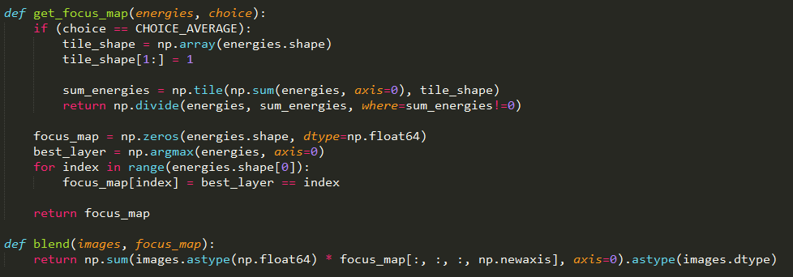
Project Development (blending)
Finally, given some energy map, we need a way to blend the images. I wanted to try two methods: the highest energy, and a blend weighted by energy. Both are implemented in the snippet to the right.
The average choice is straightforward. That little bit with np.divide is just a way to avoid warnings about division by zero.
With the max option, the blending weight for each pixel gets set to 1 for the layer with the highest energy and 0 for the other layers.
Lastly, we blend them all together.

Slide 21
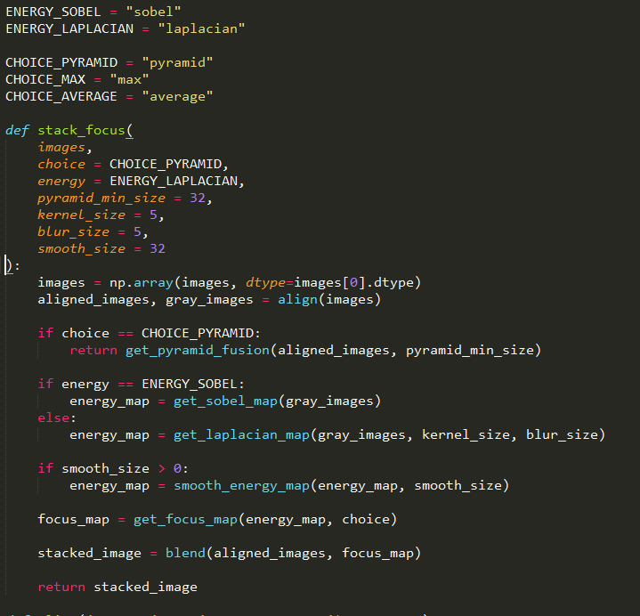
Project Development (API)
All this functionality is exposed through a simple stack_focus function, which takes some parameters to control the pixel selection strategy, blurring amounts, and smoothing amount.
You’ll notice that some of the options are implemented as module constants, inspired by OpenCV (e.g. cv2.BORDER_REFLECT, cv2.IMREAD_COLOR, etc.).
This API underwent several changes during development as it became more clear what the options available to the user should be. For example, the pyramid method was an ENERGY constant at first and later changed to be a CHOICE constant. If I were to take this further, I would add alignment iterations and epsilon to the user-configurable parameters.
After running several tests with this simple algorithm, I was getting unexpectedly good results. I even considered abandoning the pyramid method since my results were quite usable. But I started out with the intent of replicating a paper, and that’s what I was going to do, damn it!

Slide 22
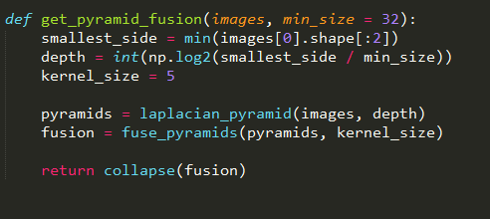
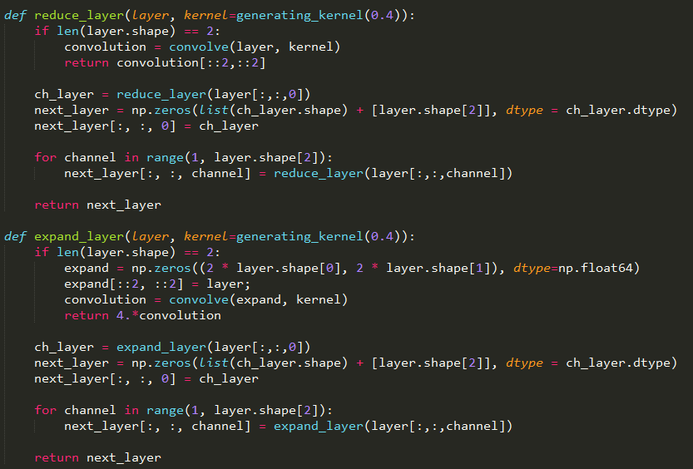
Project Development (pyramid skeleton)
Which brings us to the pyramid module! I decided to implement this as a submodule of the focus_stack module.
I started off by copying over the code from the blending assignment. Taking a look at main.py from that assignment, I noticed that it was constructing and handling the pyramids for each channel separately. That’s a poor developer experience, so I changed that to be able to handle a whole stack of color images.
One of the important changes to make that happen was making reduce_layer and expand_layer recurse on the channels. If a color image is passed, they recurse to the single-channel base-case.

Slide 23
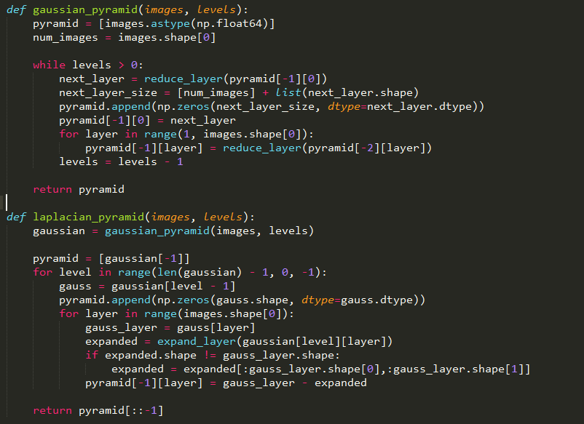
Project Development (pyramid skeleton)
Another important change was making gaussian_pyramid and laplacian_pyramid able to accept a stack of images, not just a single image, and construct a list of numpy arrays, where each array is the pyramid layer for all of the images. I thought this would be important for efficient vectorization later on.
That vectorization thing? I was right.

Slide 24
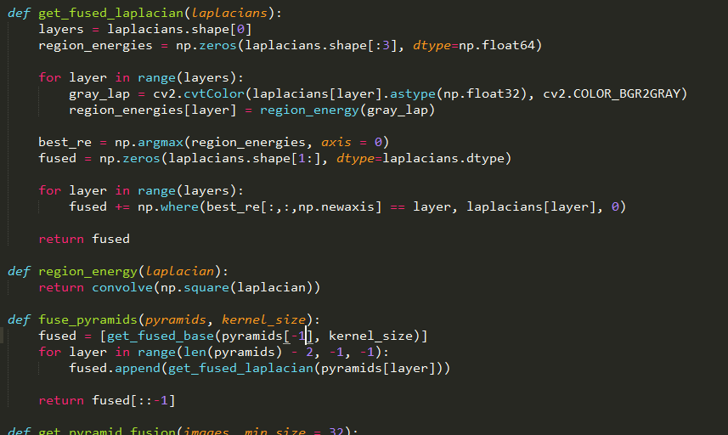
Project Development (laplacian fusion)
Alright, so we have our pyramid stack. Now… what do we do with it?
Fuse it, of course! As outlined in the diagram above, fusing pyramids is a matter of fusing the base subsambled image then each Laplacian layer.
Fusing the Laplacian layers is shown on the right. The grayscale version of each layer is calculated, then the region energy is calculated for each layer. Each pixel in the fused layer is given the value of that pixel in the layer with the highest region energy at that pixel.
As mentioned above, region energy is simply a convolution of the square of the Laplacian with the same binomial kernel used to generate the pyramid. This is done using scipy.ndimage.convolve().

Slide 25
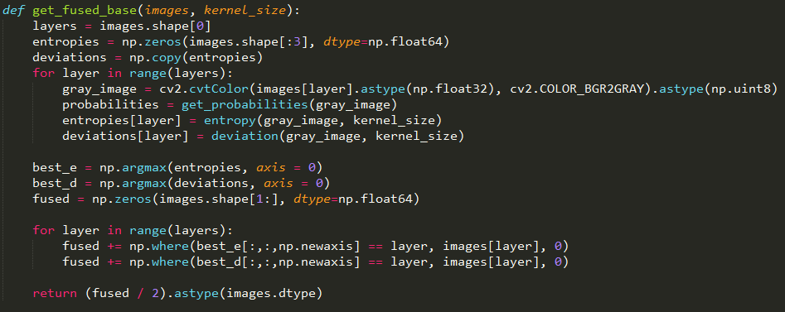
Project Development (base fusion)
Fusing the base involves converting each image to grayscale, then calculating the entropy and deviation of each pixel for each image.
Once those are found, each pixel in the fused base image is just an average of that pixels value in the layers with the highest entropy and highest deviation at that pixel. If those are the same layer, then the pixel’s value in the fused image is equal to its value in that layer.

Slide 26
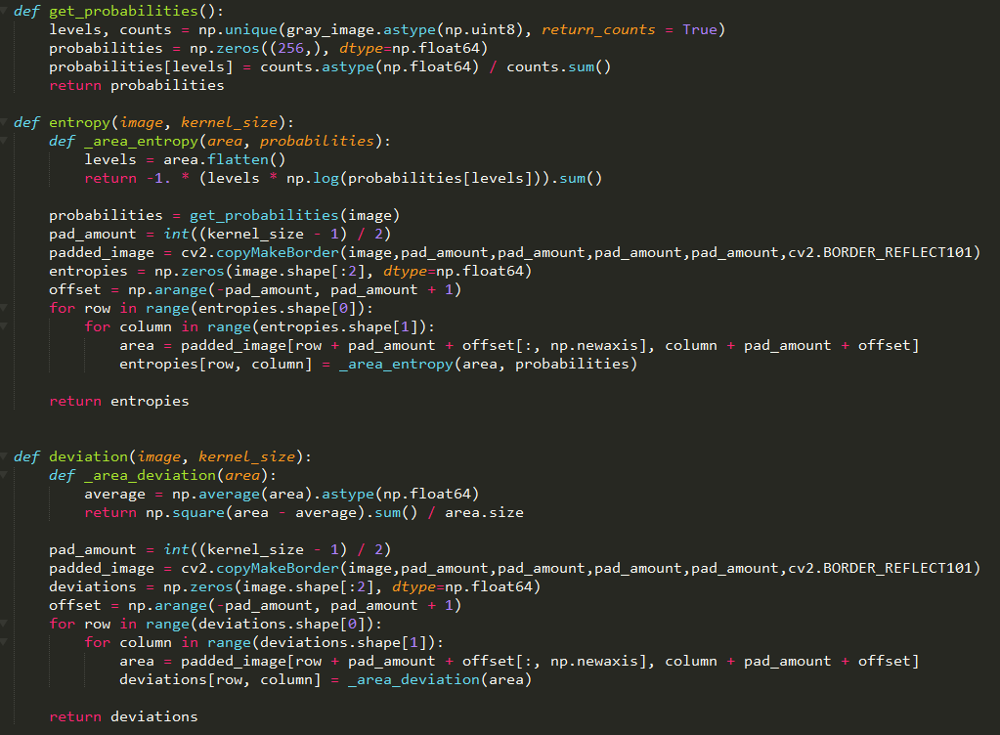
Project Development (e&d)
So, how about that entropy, huh? Since it’s not a linear function, it’s not as easy as just a convolution. Instead, I have two nested loops that loop over all pixels to calculate the entropy in the region around that pixel. The image is first padded with cv2.BORDER_REFLECT101.
The process for deviation and entropy is exactly the same. Hopefully the code here helps you understand the formulae given above (or at least my interpretation of those formulae).
If you’re anything like me, the lack of vectorization here makes you sad. Don’t worry, we can make it better later. I promise!

Slide 27
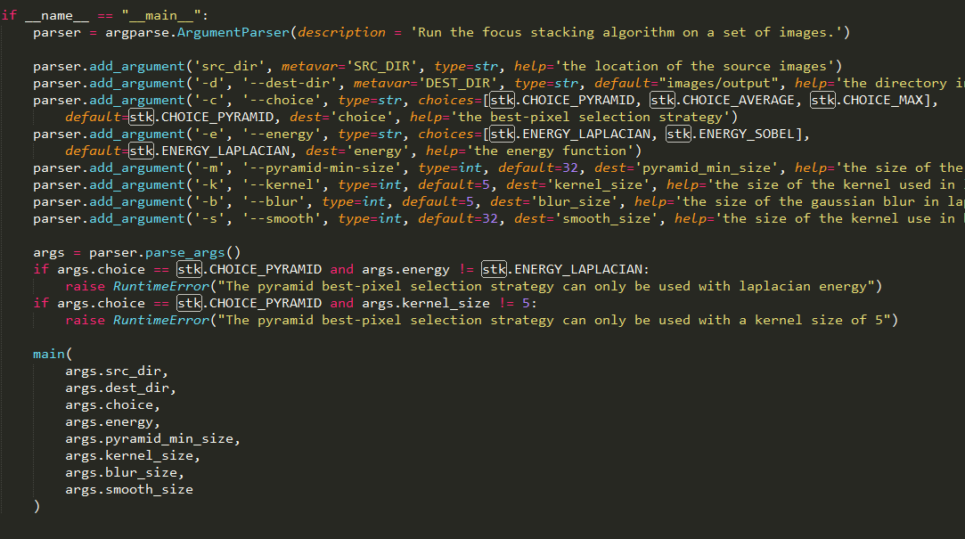
Project Development (CLI)
Finally, we come to the CLI. I placed this in a file called __main__.py. When running the module as python –m focus_stack -h, it will explain all the relevant options and parameters needed to generate focus-stacked images from the command line.

Slide 28
Project Development (retrospective)
I’m very glad that I put together the focus stacking pipeline end-to-end before implementing the pyramid method. The first iteration of the pyramid method gave very poor results because of a silly typo in get_pyramid_fusion(). If I hadn’t been sure that the pipeline process was sound, I could have spent untold hours searching in the wrong place for the issue.
I’m not sure if my implementations of the entropy and deviation functions are exactly what Wang and Chang intended. It was unclear to me how the gray-level probabilities should be calculated. I chose to calculate them independently for each image as a whole. I’m also not a huge fan of the nested loops in deviation() and entropy(). I like it when things are well-vectorized, and the performance cost of these loops make me a sad panda.
The ECC alignment method, though simpler, also seems much slower. The bulk of the processing time in this pipeline is actually spent in aligning the images. To be honest, I did not spend much time looking at this step because a) it worked, and b) this is a focus-stacking project, not an alignment project. Still, I wonder if perhaps the default values I used for the ECC algorithm are the cause of the slowdown.
If I were to take this project further, I would spend some time on:
Vectorizing the entropy() and deviation() functions
Speeding up the image alignment process, perhaps by using more reasonable defaults
Giving the user the ability to control the alignment process when calling stack_focus()
Removing redundant calls to cv2.cvtColor(), to make images grayscale
Overall, though, I’d have to say: mission accomplished!

Slide 29
Resources
http://www.ece.drexel.edu/courses/ECE-C662/notes/LaplacianPyramid/laplacian2011.pdf
https://cs.uwaterloo.ca/~vanbeek/Publications/focusStacking.pdf
https://www.learnopencv.com/image-alignment-ecc-in-opencv-c-python/
http://www.wonderfulphotos.com/articles/macro/focus_stacking/
https://stackoverflow.com/questions/15911783/what-are-some-common-focus-stacking-algorithms
Computational Photography @ GT

